Slide 1

Ansible Knowing better the Tool
Presented by
Sergio Borges
Network Automation Engineer

Slide 2

Introduction to Ansible
Ansible is a radically simple IT automation platform that makes your applications and systems easier to deploy.
It support configuration management with examples as below.
Configuration of servers
Application deployment
Continuous testing of already installed application
Provisioning
Automation of tasks

Slide 3
Why Automation?
Tasks in code
Collaboration
Eliminate errors
Write once
Laziness
Etc….

Slide 4


Why Ansible
It is a free open source application
Agent-less – No need for agent installation and management
Python/yaml based
Highly flexible and configuration management of systems.
Large number of ready to use modules for system management
Custom modules can be added if needed
Configuration roll-back in case of error
Simple and human readable
Self documenting

Slide 5

Ansible Configuration Management Workflow
SSH
Connection
Infrastructure

Slide 6
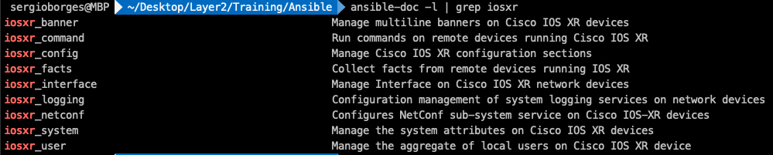
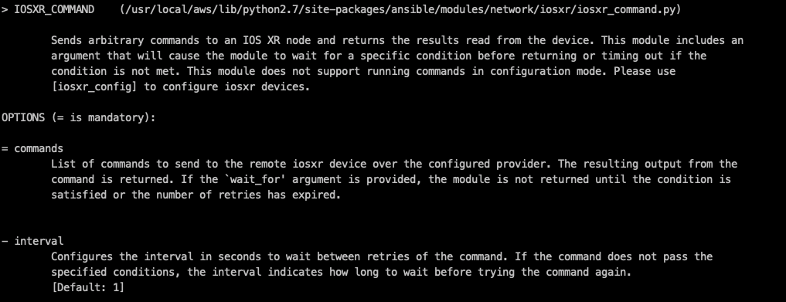
Modules Documentation
http://docs.ansible.com/

Slide 7
Configuration of Ansible Inventory Host
Do the following from Management Server machine
Create a list of client machines that you wish to configure
Create a file called : hosts
cat > hosts <<EOF
[servers]
10.102.32.11
10.102.32.12
10.102.32.1[3:4]
[servers:vars]
ansible_ssh_user=root
ansible_ssh_pass=root
EOF

Slide 8
Creating the First ansible-playbook template
Create a template to execute “show version” on Router with content as shown below and save as cisco.yml
---
- name: Network Getting Started First Playbook
gather_facts: false
hosts: cisco
connection: local
tasks:
- name: run show version on remote devices
iosxr_command:
commands: show version

Slide 9
INTERESTING TIPS about YAML FILE FORMAT
Playbooks are idempotent, meaning change commands are not run unless needed.
Every playbook configuration always begins with triple dash (---)
Playbooks doesn’t recognize tabs only SPACES for organize the structure.
Playbooks has the Follow basic sections:
NAME: good for keeping the Playbooks readable and what the playbook try to run
HOST: identifies the target for Ansible to run against
TASKS: Here is where all steps of playbook will follow
Playbooks use the concept of key:value pair to define the content
Debug can be executed on specific task or also from all playbook execution
E.g : ansible-playbook cisco.yml --vvv (each V can show more information max: 4 )

Slide 10
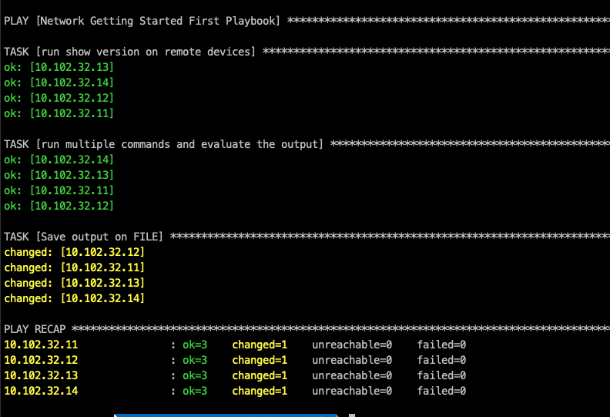
Understanding ansible playbook
The output of the ansible-playbook command as below

Slide 11
ANSIBLE VARIABLES
Extra vars
Task vars (only for the task)
Block vars (only for tasks in the block)
Role and include vars
Play vars_files
Play vars_prompt
Play vars
Set_facts
Registered vars
Hosts facts
Playbook host_vars
Playbook group_vars
Inventory host_vars
Inventory group_vars
Inventory vars
Role defaults
https://docs.ansible.com/ansible/latest/user_guide/playbooks_variables.html

Slide 12
Ansible Documentations
You can find more explanation in the Ansible Docs or Online.
Ad-hoc commands
Inventories
Variables
Modules
Playbook Roles
https://docs.ansible.com/ansible/latest/index.html

Slide 13
Templating with Ansible (Jinja2)
Ansible uses Jinja2 templating to enable dynamic expressions and access to variables.
It is possible to add programming Logic on each template to automate your task and each Field content between
{{ variable name }} will call a key:value variable referenced on files or embedded on Playbook.
vrf {{ l3vpn.vrf.name }} <- Reference to vrf name in variable.yml file
description {{l3vpn.vrf.vrf_descripton}}
address-family ipv4 unicast
import route-target
{% for rtImport in l3vpn.vrf.rtImportList %} <- Looping for each object in variable.yml file
{{rtImport}}
{% endfor %} <- End Loop logic
!
export route-target
{% for rtExport in l3vpn.vrf.rtExportList %}
{{rtExport}}
{% endfor %}
!
!
!
https://docs.ansible.com/ansible/latest/user_guide/playbooks_templating.html

Slide 14
DEMO LAB
Download the source code:
https://github.com/borgessc/ansible_it.br

Slide 15

It’s time to be a Hero
Let’s automate!
Thank you

